Slide 1
Predicting coma outcome
DATA SCIENCE PROJECT
Group 76:
Nischal Neupane, MSc computer science
Mario boot, PhD traffic engineering
Primary topic: Data Mining

Slide 2
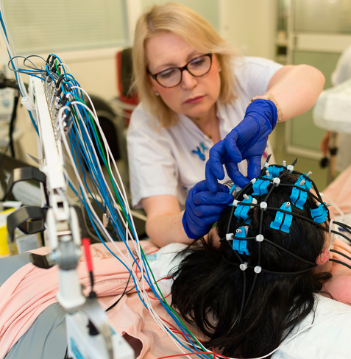

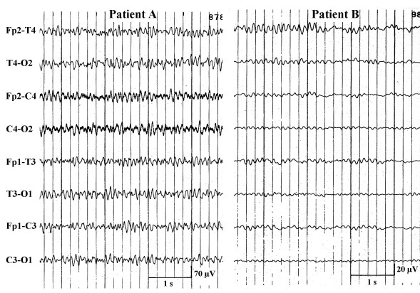
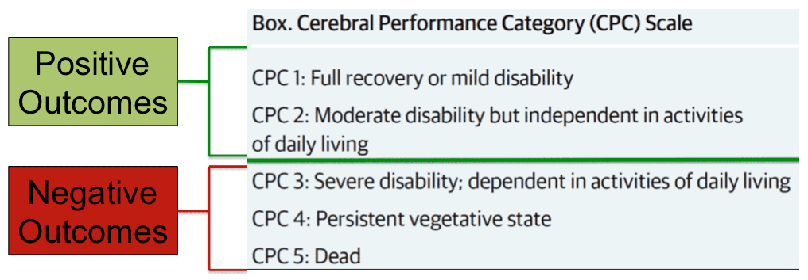
background
Predicting coma outcome remains major challenge
Manual analysis is time-consuming, subject to inter-rater variance, needs expensive experts
Cerebral Performance Category Score (CPC) and Cerebral Recovery Index (CRI) are developed
Patients in coma at t=0, EEG data measured at t=12h and t=24h. Outcome labelled by 1 or 0.
Quantitative models deserve more attention

Slide 3
Main Research question
How do different classification models compare in terms of accuracy and sensitivity?

Slide 4
Data science Steps (Not) taken
Included
Excluded
Data preprocessing: check data types and data cleanliness
Select potentially suitable models
Feature engineering: calculating averages
Split into test a training sets; select hyperparameters with GridSearchCV; train models
Obtain modelling results in terms of accuracy, sensitivity, AUC curves
Interpretation
Extensive data quality investigations
K-fold cross validation
Feature removal

Slide 5
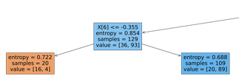
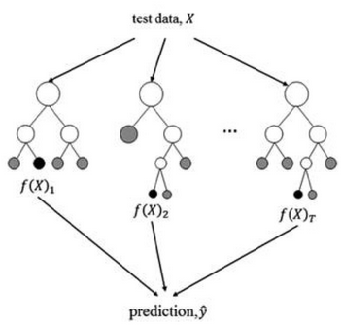
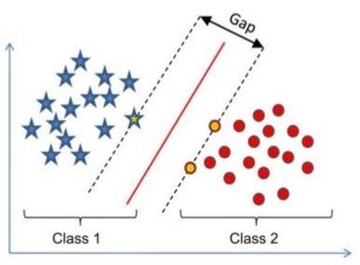
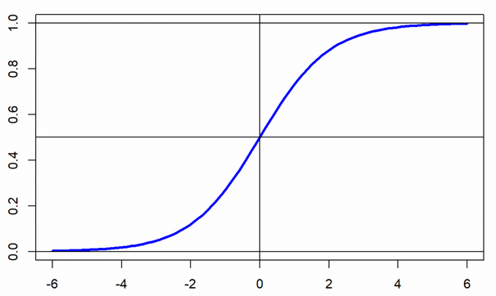
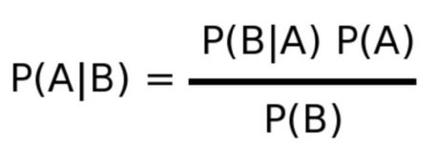
Characteristics of the 5 models used
Logistic Regression
Decision Trees
Random Forests
Naïve Bayes
Support Vector Machines
For continuous variables
For categorical data
For categorical data
For probabilistic data with independent features
For clearly distinguishable categories

Slide 6
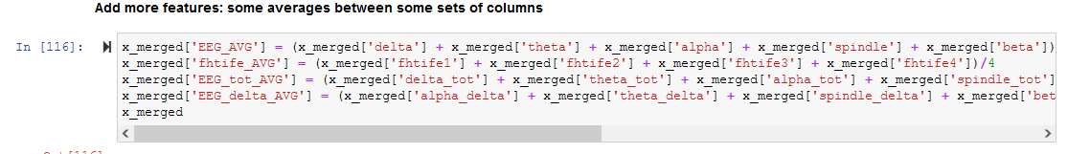
Feature engineering

Slide 7
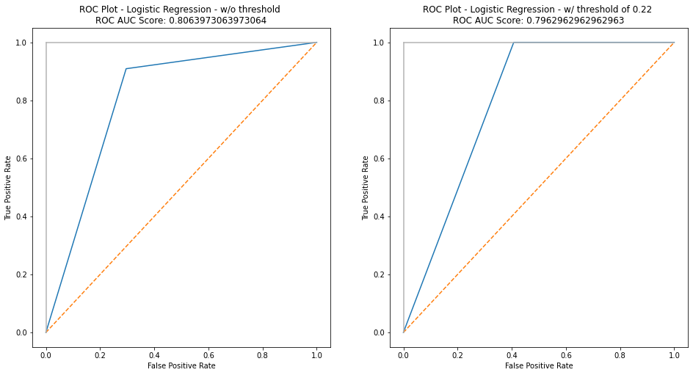
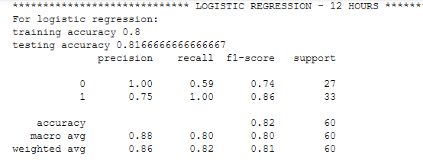
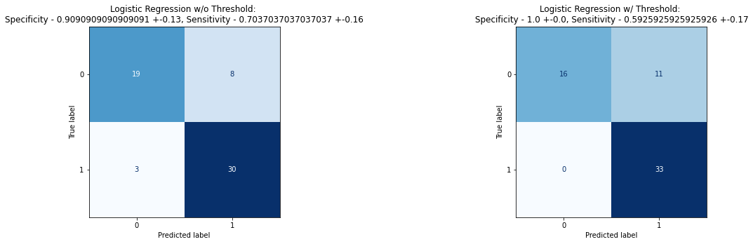
Example of Model outcomes

Slide 8
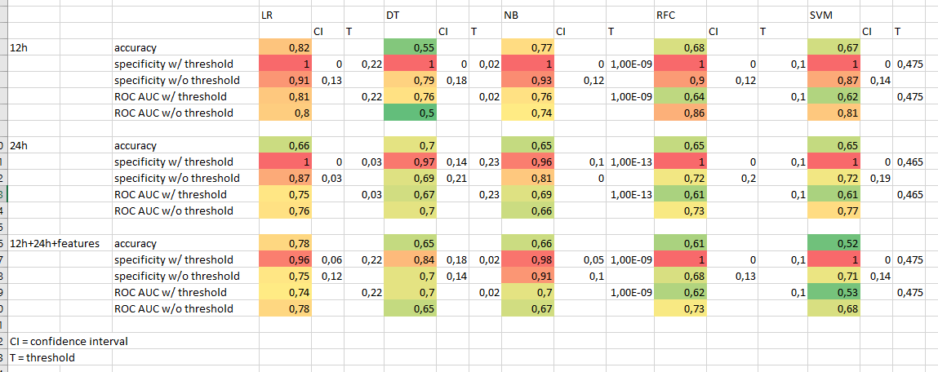
Overview of Model outcomes

Slide 9
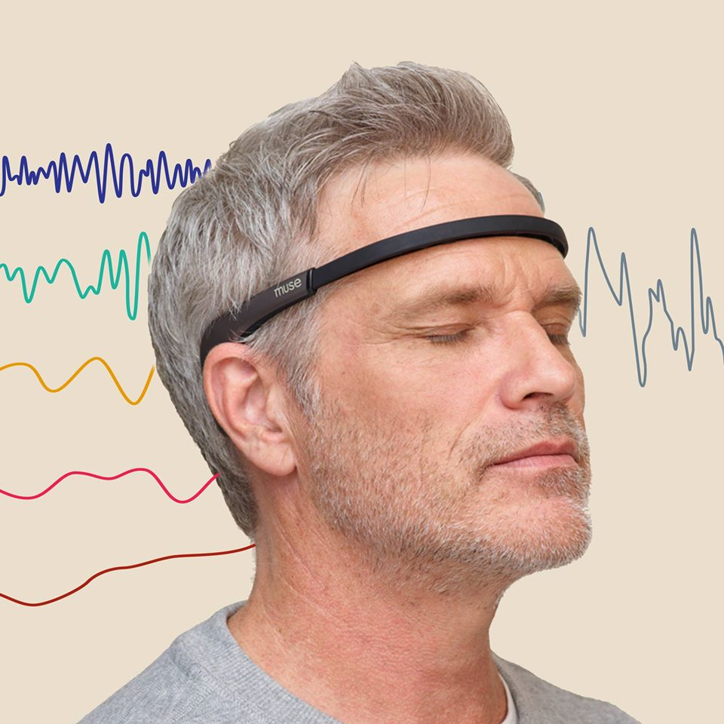
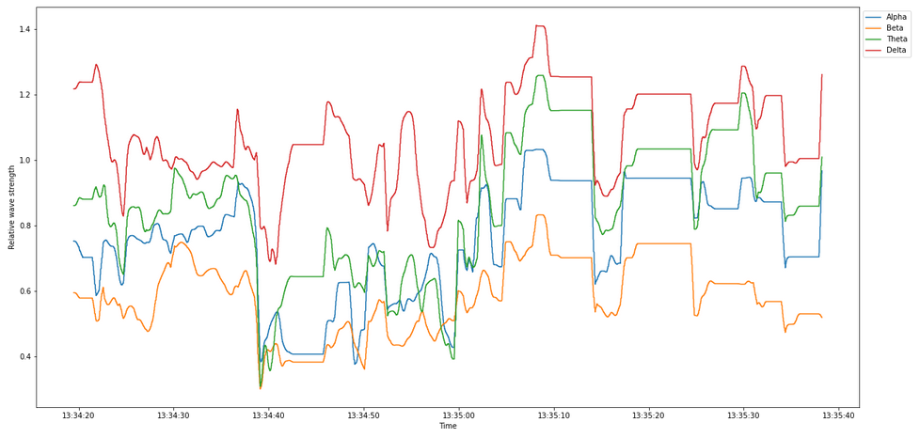
Side activity: Muse headband
EEG data can be valuable for Mario’s PhD project about user experience
Previous research confirmed EEG’s potential to classify stress & meditation states
Conducted experiments: 1 min. game, 1 min. meditation, 1 min. game
Question: can we detect meditative states?
Complexity in data cleaning and windowing
Needed to terminate to ensure success in coma EEG project

Slide 10
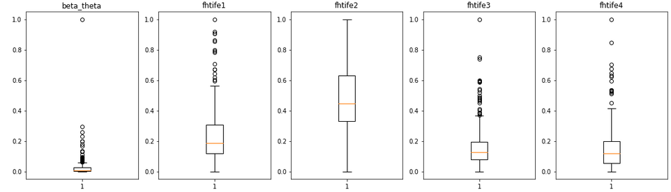
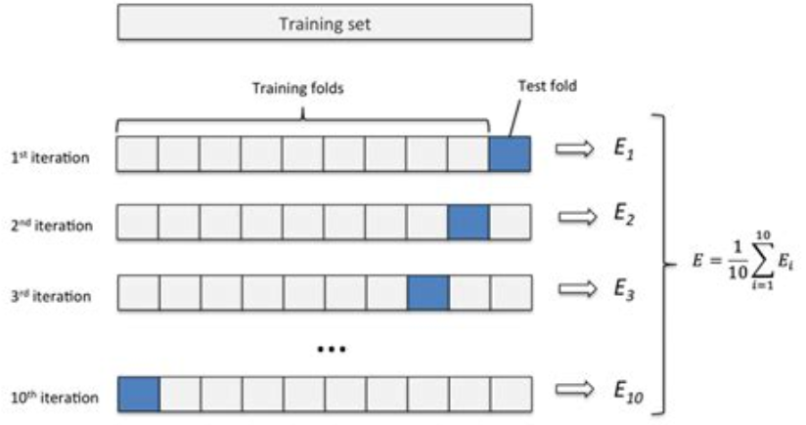
Potential Next steps
Check for non-contributing features and remove these
Check for skewness in data and replace outliers by interpolations
K-Fold Cross validation
Report on optimal parameters by GridSearchCV
Compare approach to other studies

Slide 11
discussion
Achieved acceptable modelling outcomes
False negatives are to be avoided
Our feature engineering decreased modelling results
In-depth understanding of mechanics of models needs more work
Muse EEG side-activities valuable but complex
Went beyond course material via GridSearchCV, SVMs, and Muse EEG activities
In general: valuable learning about data science
Notes:
Recap of Faiza’s feedback:
Ensure that all things included in presentation are also included in report
Describe which data analysis steps influence (improve/decrease) accuracy
Why did we select the 5 models that we used
Feature selection / removal: which features and why? What’s the point of feature extraction

